Slide 1
STM32F4 Overview
HCM - 2021

Slide 2
Agenda
STM32F4 overview
Power supply
Clock tree
Boot process

Slide 3
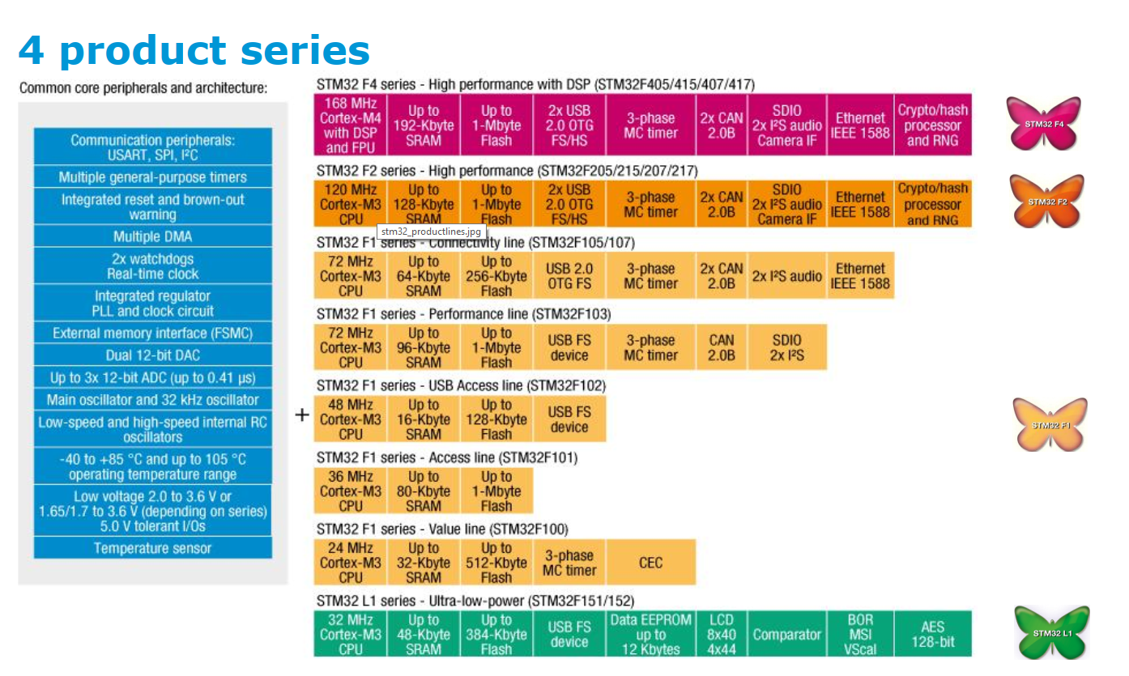
STM32F4 Series

Slide 4
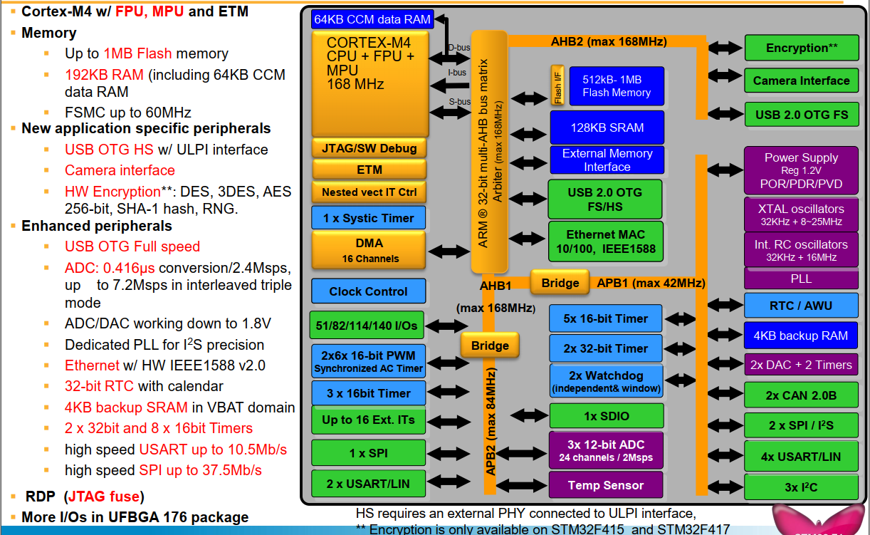
STM32F4xx Block Diagram

Slide 5
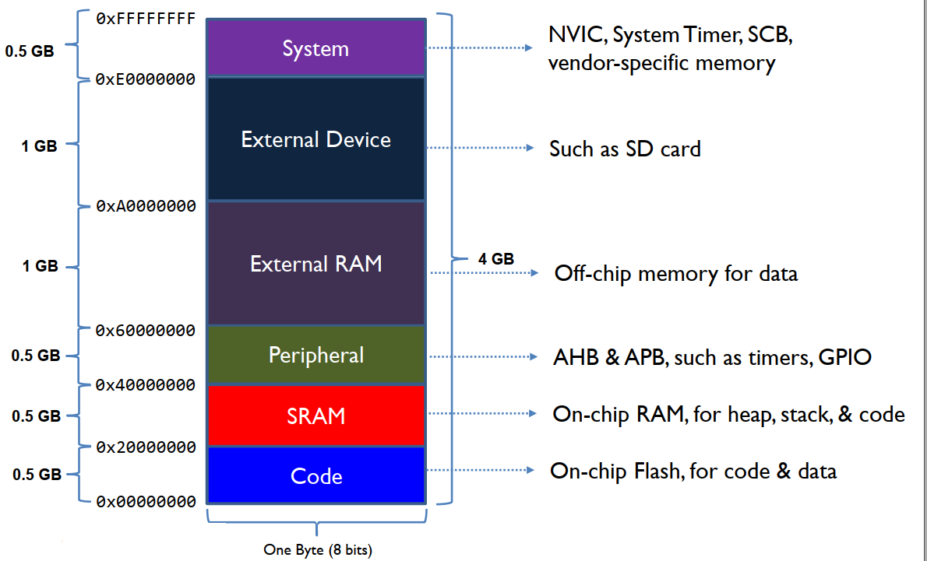
Memory Map of Cortex-M4

Slide 6
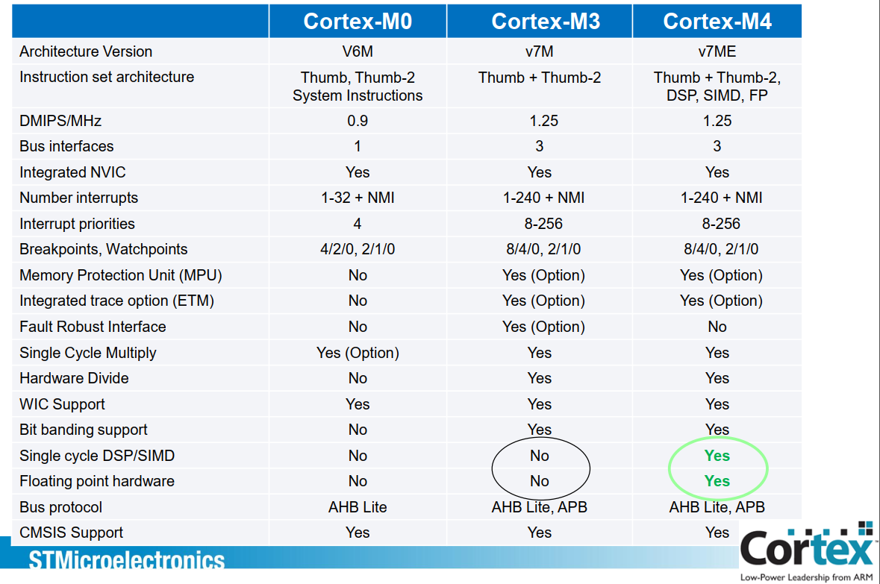
Cortex-M feature set comparison

Slide 7
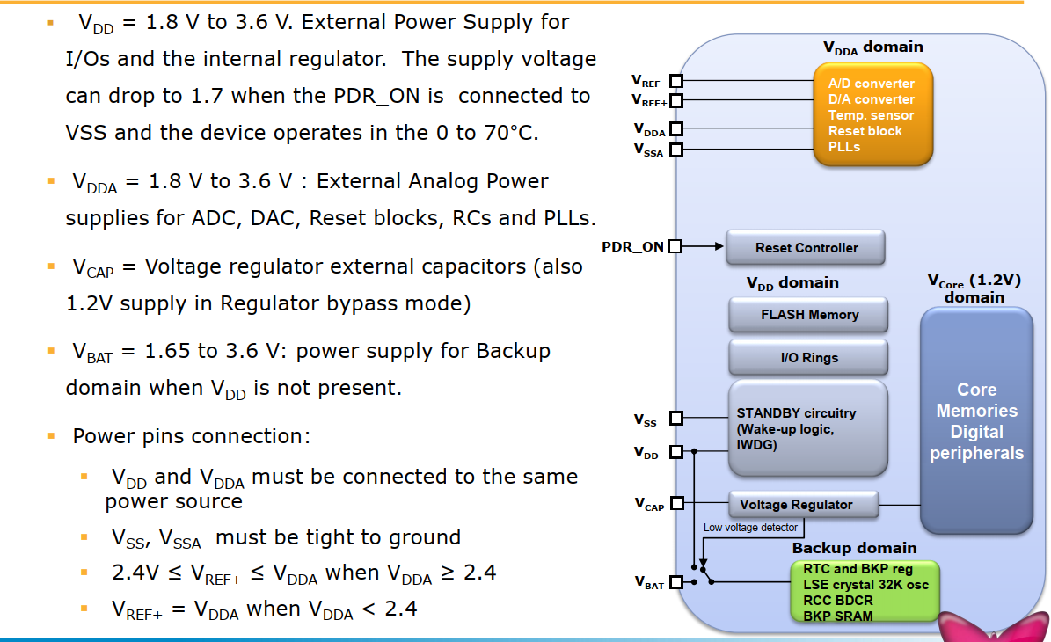
Power Supply

Slide 8
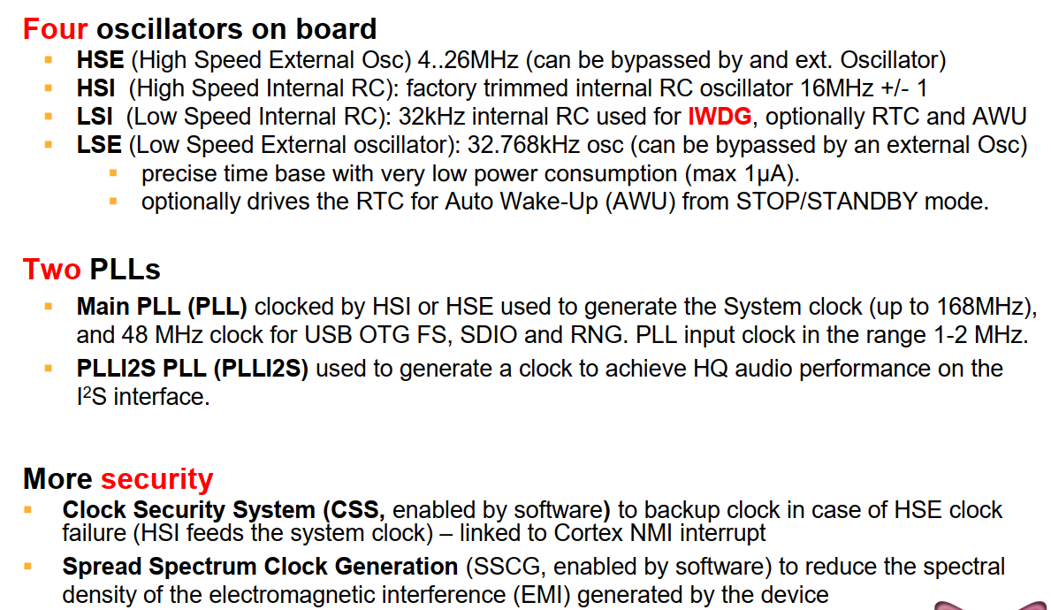
STM32F4 – clock features

Slide 9
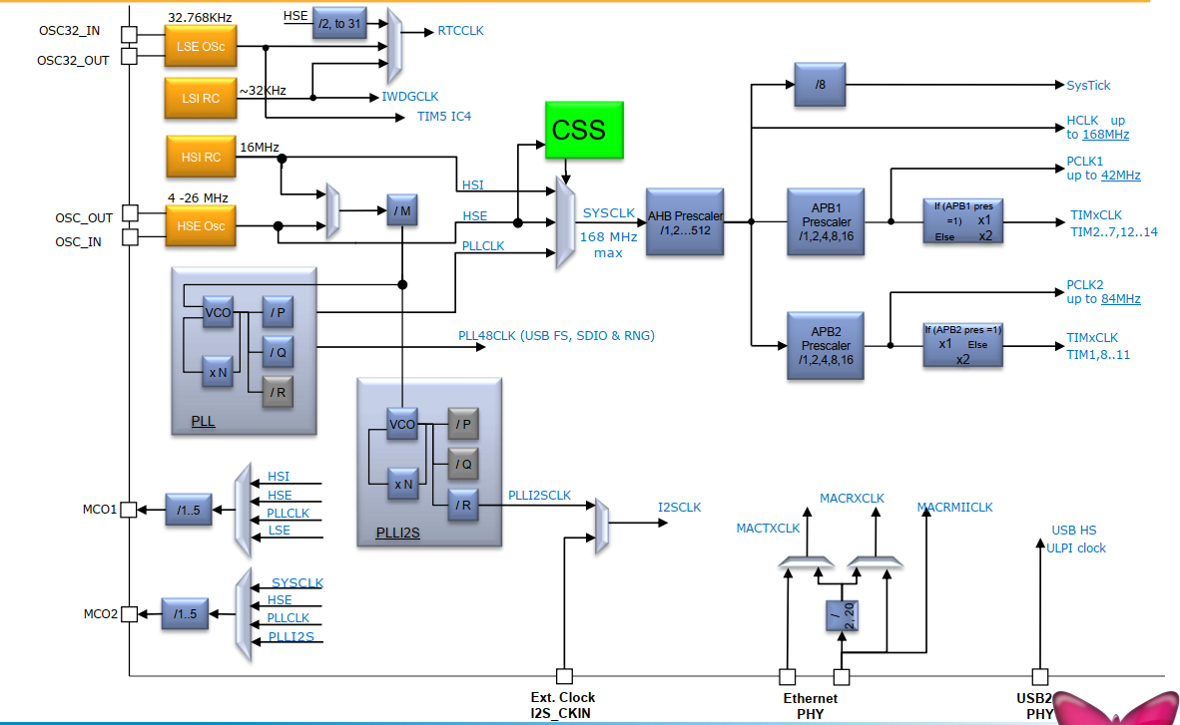
STM32F4 – clock scheme

Slide 10
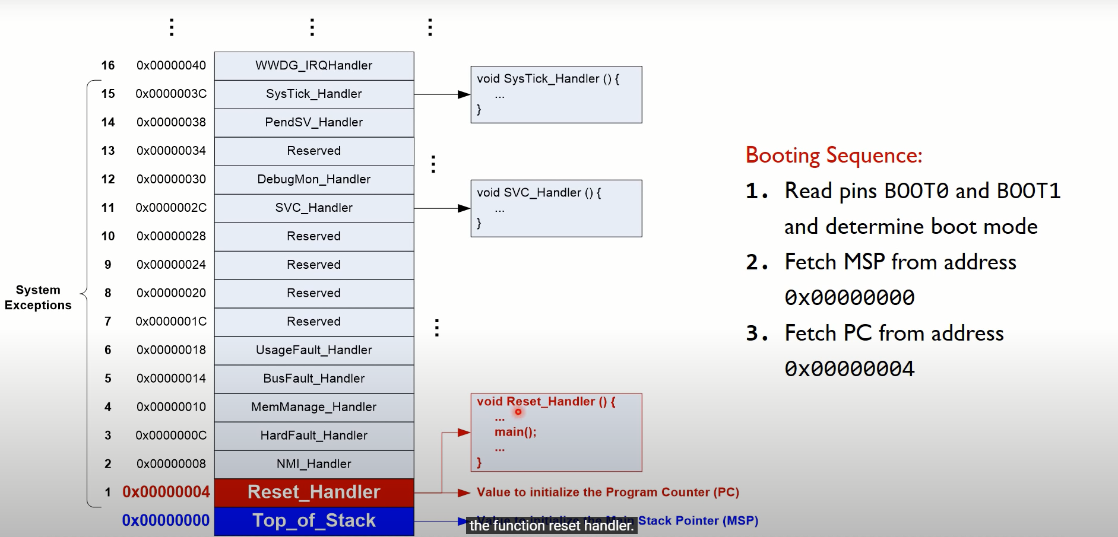
Boot process

Slide 11
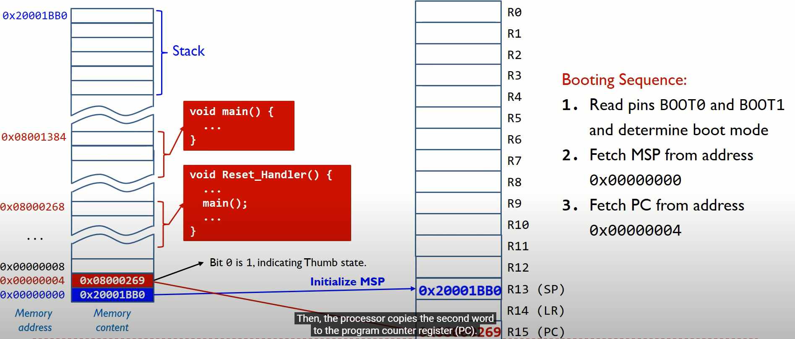
Boot process

Slide 12
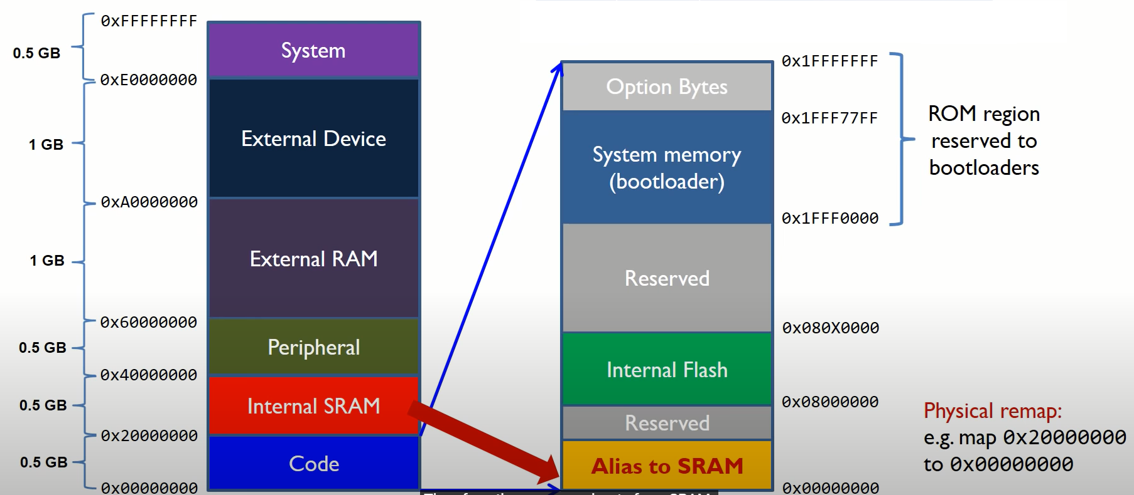
Boot process

Slide 13
Question ?

